Slide 1
21
The Immune System: Innate and Adaptive:Body Defenses: Part A

Slide 2
Immunity
Resistance to disease
Immune system has two intrinsic systems
  Innate (nonspecific) defense system
  Adaptive (specific) defense system

Slide 3
Immunity
Innate defense system has two lines of defense
  First line of defense is external body membranes (skin and mucosae)
  Second line of defense is antimicrobial proteins, phagocytes, and other cells
    Inhibit spread of invaders
    Inflammation is its most important mechanism

Slide 4
Immunity
Adaptive defense system
  Third line of defense attacks particular foreign substances
    Takes longer to react than the innate system
Innate and adaptive defenses are deeply intertwined

Slide 5
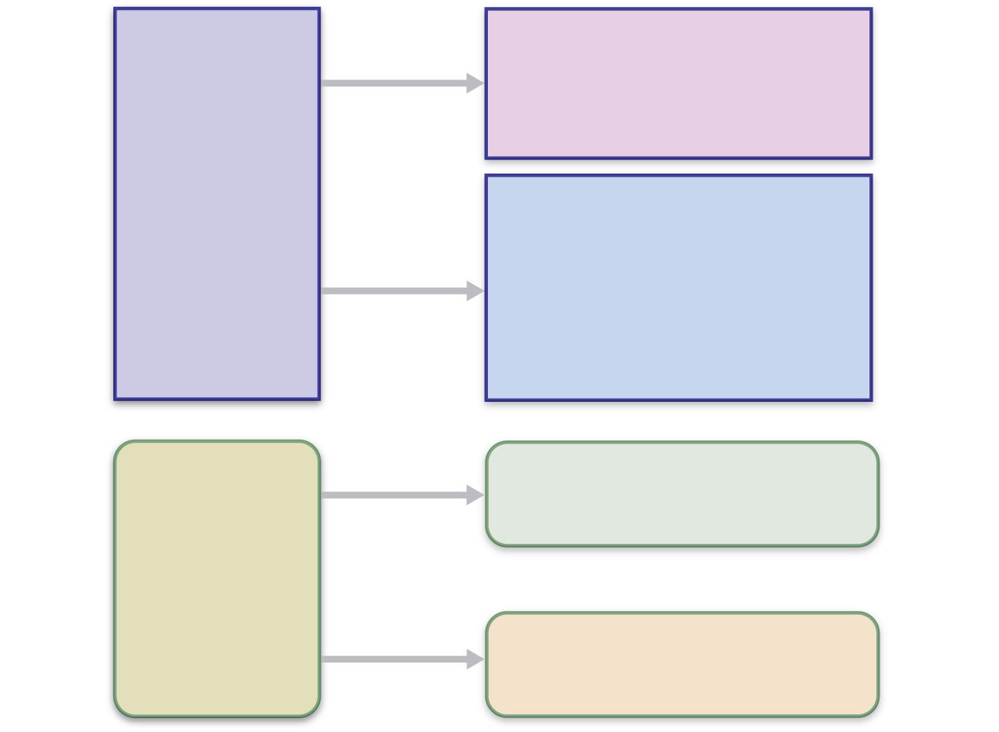
Surface barriers
• Skin
• Mucous membranes
Innate
defenses
Internal defenses
• Phagocytes
• NK cells
• Inflammation
• Antimicrobial proteins
• Fever
Humoral immunity
• B cells
Adaptive
defenses
Cellular immunity
• T cells
Figure 21.1

Slide 6
Innate Defenses
Surface barriers
  Skin, mucous membranes, and their secretions
    Physical barrier to most microorganisms
    Keratin is resistant to weak acids and bases, bacterial enzymes, and toxins
  Mucosae provide similar mechanical barriers

Slide 7
Surface Barriers
Protective chemicals inhibit or destroy microorganisms
  Skin acidity
  Lipids in sebum and dermcidin in sweat
  HCl and protein-digesting enzymes of stomach mucosae
  Lysozyme of saliva and lacrimal fluid
  Mucus

Slide 8
Surface Barriers
Respiratory system modifications
  Mucus-coated hairs in the nose
  Cilia of upper respiratory tract sweep dust- and bacteria-laden mucus from lower respiratory passages

Slide 9
Internal Defenses: Cells and Chemicals
Necessary if microorganisms invade deeper tissues
  Phagocytes
  Natural killer (NK) cells
  Inflammatory response (macrophages, mast cells, WBCs, and inflammatory chemicals)
  Antimicrobial proteins (interferons and complement proteins)
  Fever

Slide 10
Phagocytes: Macrophages
Macrophages develop from monocytes to become the chief phagocytic cells
    Free macrophages wander through tissue spaces
      E.g., alveolar macrophages
    Fixed macrophages are permanent residents of some organs
      E.g., Kupffer cells (liver) and microglia (brain)

Slide 11
Phagocytes: Neutrophils
Neutrophils
  Become phagocytic on encountering infectious material in tissues

Slide 12
Natural Killer (NK) Cells
Large granular lymphocytes
Target cells that lack “self” cell-surface receptors
Induce apoptosis in cancer cells and virus-infected cells
Secrete potent chemicals that enhance the inflammatory response

Slide 13
Inflammatory Response
Triggered whenever body tissues are injured or infected
Prevents the spread of damaging agents
Disposes of cell debris and pathogens
Sets the stage for repair

Slide 14
Inflammatory Response
Cardinal signs of acute inflammation:
  Redness
  Heat
  Swelling
  Pain
  (And sometimes 5. Impairment of function)

Slide 15
Inflammatory Response
Macrophages and epithelial cells of boundary tissues bear Toll-like receptors (TLRs)
TLRs recognize specific classes of infecting microbes
Activated TLRs trigger the release of cytokines that promote inflammation

Slide 16
Inflammatory Response
Inflammatory mediators
  Histamine (from mast cells)
  Blood proteins
  Kinins, prostaglandins (PGs), leukotrienes, and complement
    Released by injured tissue, phagocytes, lymphocytes, basophils, and mast cells

Slide 17
Vasodilation and Increased Vascular Permeability
Inflammatory chemicals cause
  Dilation of arterioles, resulting in hyperemia
  Increased permeability of local capillaries and edema (leakage of exudate)
Exudate contains proteins, clotting factors, and antibodies

Slide 18
Inflammatory Response: Edema
Functions of the surge of exudate
  Moves foreign material into lymphatic vessels
  Delivers clotting proteins to form a scaffold for repair and to isolate the area

Slide 19
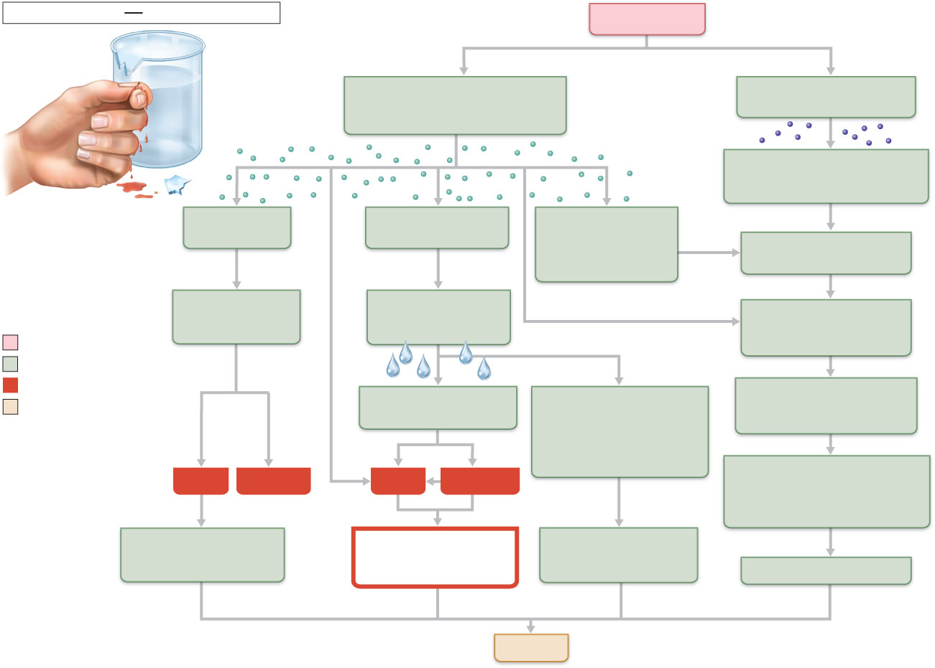
Innate defenses
Internal defenses
Tissue injury
Release of chemical mediators
(histamine, complement,
kinins, prostaglandins, etc.)
Release of leukocytosis-
inducing factor
Leukocytosis
(increased numbers of white
blood cells in bloodstream)
Vasodilation
of arterioles
Increased capillary
permeability
Attract neutrophils,
monocytes, and
lymphocytes to
area (chemotaxis)
Leukocytes migrate to
injured area
Local hyperemia
(increased blood
flow to area)
Capillaries
leak fluid
(exudate formation)
Margination
(leukocytes cling to
capillary walls)
Initial stimulus
Physiological response
Signs of inflammation
Leaked protein-rich
fluid in tissue spaces
Leaked clotting
proteins form interstitial
clots that wall off area
to prevent injury to
surrounding tissue
Diapedesis
(leukocytes pass through
capillary walls)
Result
Heat
Redness
Pain
Swelling
Phagocytosis of pathogens
and dead tissue cells
(by neutrophils, short-term;
by macrophages, long-term)
Locally increased
temperature increases
metabolic rate of cells
Possible temporary
limitation of
joint movement
Temporary fibrin
patch forms
scaffolding for repair
Pus may form
Area cleared of debris
Healing
Figure 21.3

Slide 20
Phagocyte Mobilization
Neutrophils, then phagocytes flood to inflamed sites

Slide 21
Phagocyte Mobilization
Steps for phagocyte mobilization
  Leukocytosis: release of neutrophils from bone marrow in response to leukocytosis-inducing factors from injured cells
  Margination: neutrophils cling to the walls of capillaries in the inflamed area
  Diapedesis of neutrophils
  Chemotaxis: inflammatory chemicals (chemotactic agent) promote positive chemotaxis of neutrophils

Slide 22
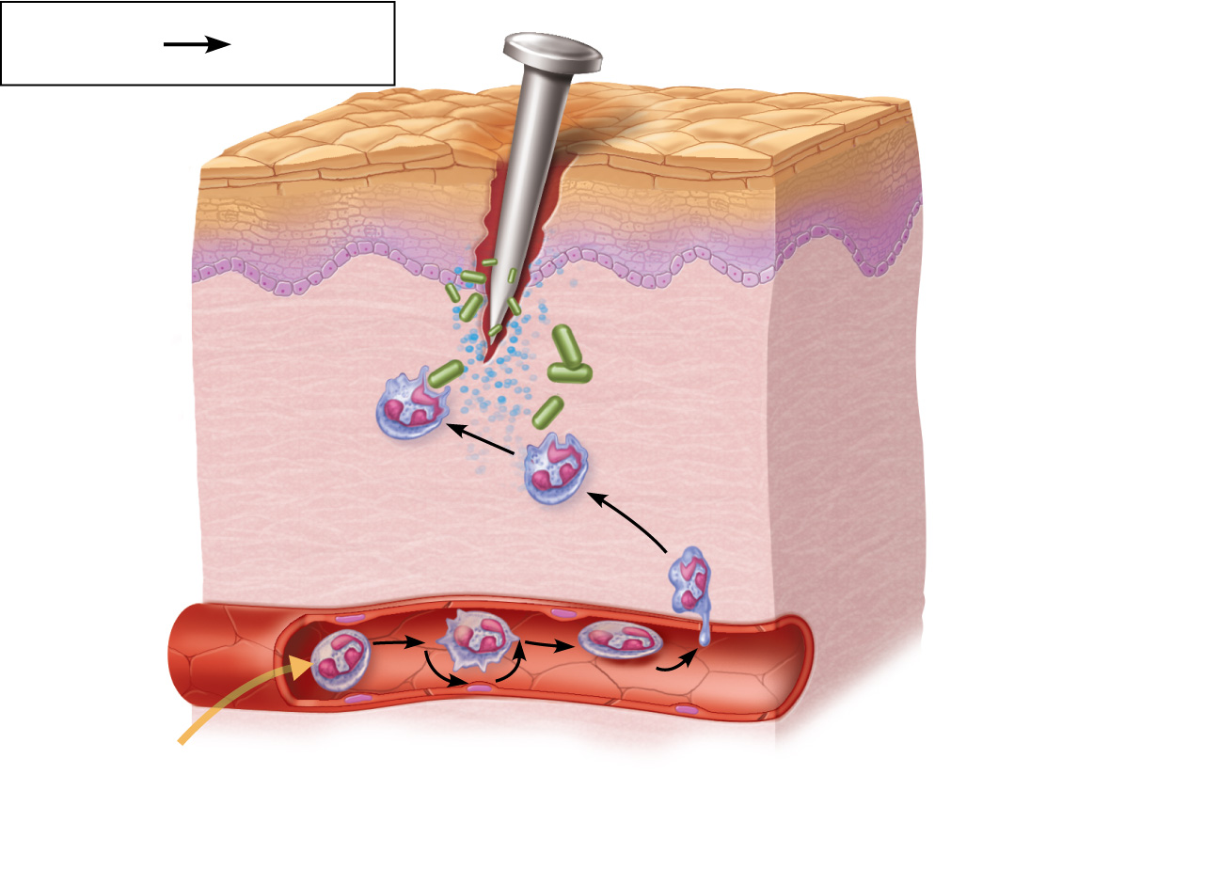
Innate
defenses
Internal
defenses
Inflammatory
chemicals
diffusing
from the
inflamed site
act as chemotactic
agents.
4
Chemotaxis.
Neutrophils
follow chemical
trail.
Capillary wall
Basement
membrane
Endothelium
1
2
3
Leukocytosis.
Neutrophils enter blood
from bone marrow.
Margination.
Neutrophils cling
to capillary wall.
Diapedesis.
Neutrophils flatten and
squeeze out of capillaries.
Figure 21.4

Slide 23
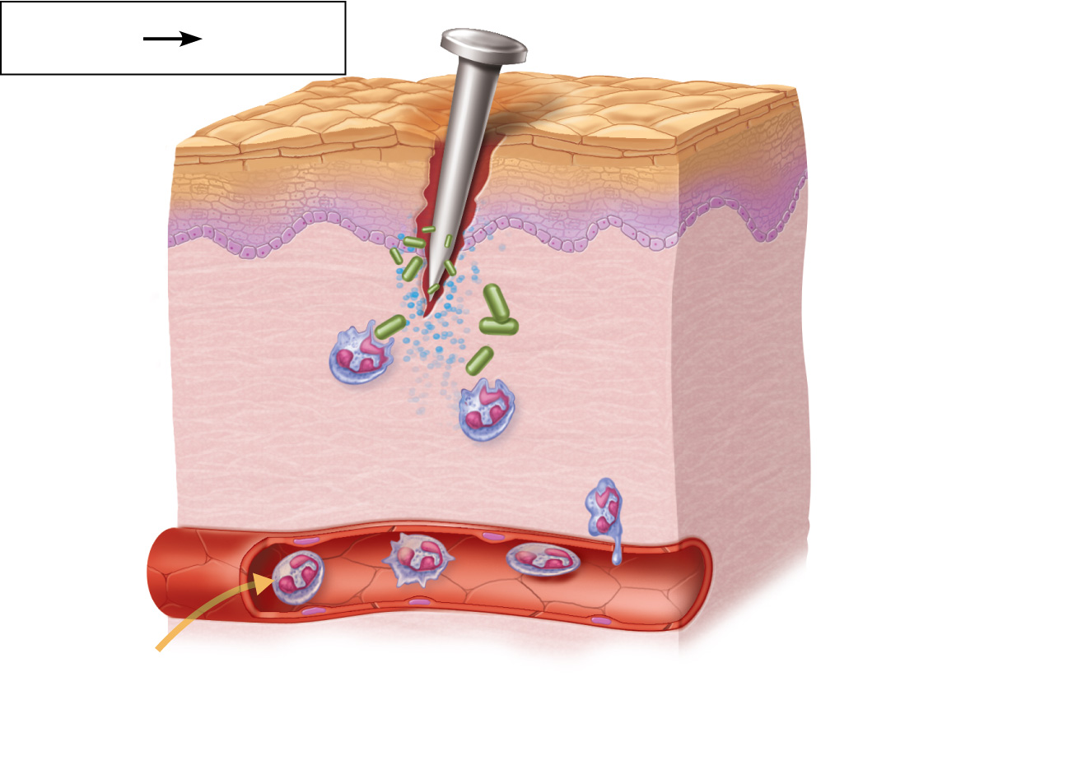
Innate
defenses
Internal
defenses
Inflammatory
chemicals
diffusing
from the
inflamed site
act as chemotactic
agents.
Capillary wall
Basement
membrane
Endothelium
1
Leukocytosis.
Neutrophils enter blood
from bone marrow.
Figure 21.4, step 1

Slide 24

Innate
defenses
Internal
defenses
Inflammatory
chemicals
diffusing
from the
inflamed site
act as chemotactic
agents.
Capillary wall
Basement
membrane
Endothelium
1
2
Leukocytosis.
Neutrophils enter blood
from bone marrow.
Margination.
Neutrophils cling
to capillary wall.
Figure 21.4, step 2

Slide 25

Innate
defenses
Internal
defenses
Inflammatory
chemicals
diffusing
from the
inflamed site
act as chemotactic
agents.
Capillary wall
Basement
membrane
Endothelium
1
2
3
Leukocytosis.
Neutrophils enter blood
from bone marrow.
Margination.
Neutrophils cling
to capillary wall.
Diapedesis.
Neutrophils flatten and
squeeze out of capillaries.
Figure 21.4, step 3

Slide 26
Innate
defenses
Internal
defenses
Inflammatory
chemicals
diffusing
from the
inflamed site
act as chemotactic
agents.
4
Chemotaxis.
Neutrophils
follow chemical
trail.
Capillary wall
Basement
membrane
Endothelium
1
2
3
Leukocytosis.
Neutrophils enter blood
from bone marrow.
Margination.
Neutrophils cling
to capillary wall.
Diapedesis.
Neutrophils flatten and
squeeze out of capillaries.
Figure 21.4, step 4

Slide 27
Antimicrobial Proteins
Interferons (IFNs) and complement proteins
  Attack microorganisms directly
  Hinder microorganisms’ ability to reproduce

Slide 28
Interferons
Viral-infected cells are activated to secrete IFNs
IFNs enter neighboring cells
Neighboring cells produce antiviral proteins that block viral reproduction

Slide 29
Interferons
Produced by a variety of body cells
  Lymphocytes produce gamma (γ), or immune, interferon
  Most other WBCs produce alpha (α) interferon
  Fibroblasts produce beta (β) interferon
  Interferons also activate macrophages and mobilize NKs

Slide 30
Interferons
Functions
  Anti-viral
  Reduce inflammation
  Activate macrophages and mobilize NK cells
Genetically engineered IFNs for
  Antiviral agents against hepatitis and genital warts virus
  Multiple sclerosis treatment

Slide 31
Complement
~20 blood proteins that circulate in an inactive form
Include C1–C9, factors B, D, and P, and regulatory proteins
Major mechanism for destroying foreign substances

Slide 32
Complement
Amplifies all aspects of the inflammatory response
Kills bacteria and certain other cell types by cell lysis
Enhances both nonspecific and specific defenses

Slide 33
Fever
Systemic response to invading microorganisms
Leukocytes and macrophages exposed to foreign substances secrete pyrogens
Pyrogens reset the body’s thermostat upward

Slide 34
Fever
High fevers are dangerous because heat denatures enzymes
Benefits of moderate fever
  Causes the liver and spleen to sequester iron and zinc (needed by microorganisms)
  Increases metabolic rate, which speeds up repair

Slide 35
Adaptive Defenses
The adaptive immune (specific defense) system
  Protects against infectious agents and abnormal body cells
  Amplifies the inflammatory response
  Activates complement

Slide 36
Adaptive Defenses
Adaptive immune response
  Is specific
  Is systemic
  Has memory
Two separate overlapping arms
  Humoral (antibody-mediated) immunity
  Cellular (cell-mediated) immunity

Slide 37
Antigens
Substances that can mobilize the adaptive defenses and provoke an immune response
Most are large, complex molecules not normally found in the body (nonself)

Slide 38
Complete Antigens
Important functional properties
  Immunogenicity: ability to stimulate proliferation of specific lymphocytes and antibodies
  Reactivity: ability to react with products of activated lymphocytes and antibodies released
Examples: foreign protein, polysaccharides, lipids, and nucleic acids

Slide 39
Haptens (Incomplete Antigens)
Small molecules (peptides, nucleotides, and hormones)
Not immunogenic by themselves
Are immunogenic when attached to body proteins
Cause the immune system to mount a harmful attack
Examples: poison ivy, animal dander, detergents, and cosmetics

Slide 40
Cells of the Adaptive Immune System
Two types of lymphocytes
  B lymphocytes (B cells)—humoral immunity
  T lymphocytes (T cells)—cell-mediated immunity
Antigen-presenting cells (APCs)
  Do not respond to specific antigens
  Play essential auxiliary roles in immunity

Slide 41
Lymphocytes
Originate in red bone marrow
  B cells mature in the red bone marrow
  T cells mature in the thymus

Slide 42
Macrophages and Dendritic Cells
Present antigens and activate T cells
  Macrophages mostly remain fixed in the lymphoid organs
  Dendritic cells internalize pathogens and enter lymphatics to present the antigens to T cells in lymphoid organs
Activated T cells release chemicals that
  Prod macrophages to become insatiable phagocytes and to secrete bactericidal chemicals

Slide 43
Active Humoral Immunity
Occurs when B cells encounter antigens and produce specific antibodies against them
  Two types
    Naturally acquired—response to a bacterial or viral infection
    Artificially acquired—response to a vaccine of dead or attenuated pathogens

Slide 44
Active Humoral Immunity
Vaccines
  Spare us the symptoms of the primary response
  Provide antigenic determinants that are immunogenic and reactive
  Target only one type of helper T cell, so fail to fully establish cellular immunological memory

Slide 45
Passive Humoral Immunity
B cells are not challenged by antigens
Immunological memory does not occur

Slide 46
Passive Humoral Immunity
Two types
  Naturally acquired—antibodies delivered to a fetus via the placenta or to infant through milk
  Artificially acquired—injection of serum, such as gamma globulin
    Protection is immediate but ends when antibodies naturally degrade in the body

Slide 47
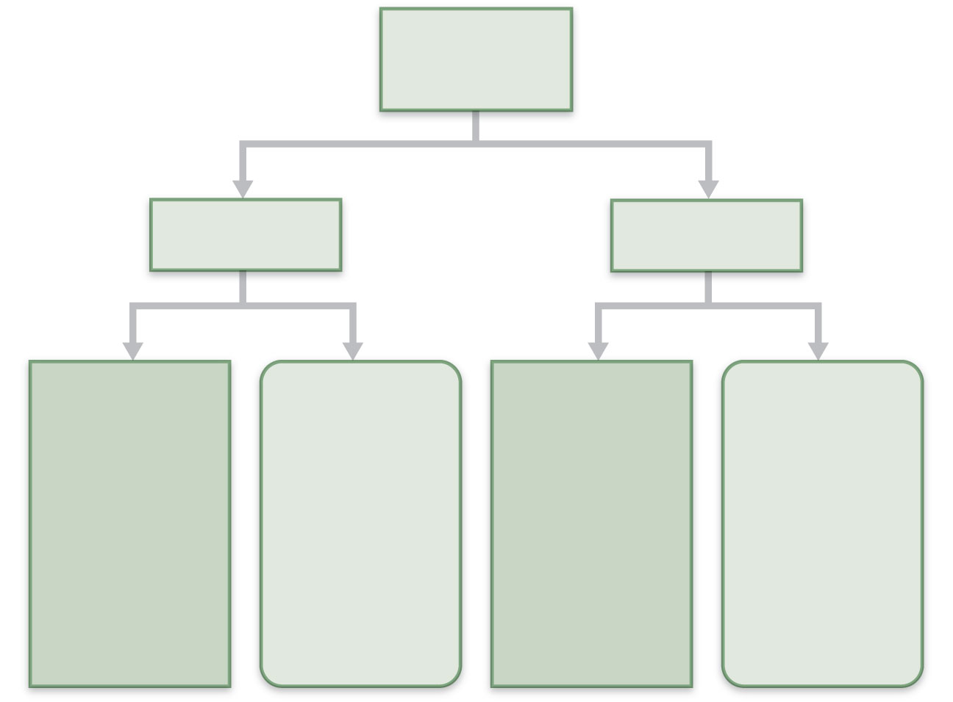
Humoral
immunity
Active
Passive
Naturally
acquired
Artificially
acquired
Naturally
acquired
Artificially
acquired
Infection;
contact
with
pathogen
Vaccine;
dead or
attenuated
pathogens
Antibodies
pass from
mother to
fetus via
placenta;
or to infant
in her milk
Injection of
immune
serum
(gamma
globulin)
Figure 21.13

